Slide 1
Adv WPF Workshop
Houston Open Spaces
4/30/2010

Slide 2
Who the hell are you?!
Jonathan Birkholz -> JB
Blog – www.theabsentmindedcoder.com
@RookieOne
GitHub – http://github.com/rookieone

Slide 3

Geek Factor
Claudio skateboards, plays guitar, rollerblades!
I play video games, read science fiction, and enjoy playoff hockey
Raptr.com/rookieone
www.goodreads.com/user/show/3300815-jonathan-birkholz

Slide 4
Purpose
Teach you something new
Rethink something you thought you new
Have you examine how you see and work with Xaml

Slide 5

Demo Time!
When we see this
It means there it is time to jump into code

Slide 6
Advanced?
Do I need to know WPF? – No
Can I follow along? – Yes
When can I ask questions? – Anytime
If someone can write a book on LINQ, then I can call this workshop advanced - JB

Slide 7
Where do we start?

Slide 8
Revisit dependencies

Slide 9
What is a Dependency Object?
The base class for any object that can support dependency properties. – WPF Unleashed

Slide 10
Object
Dispatcher Object
Dependency Object
Freezable
Visual
ContentElement
UIElement
FrameworkElement
Control
FrameworkContentElement

Slide 11
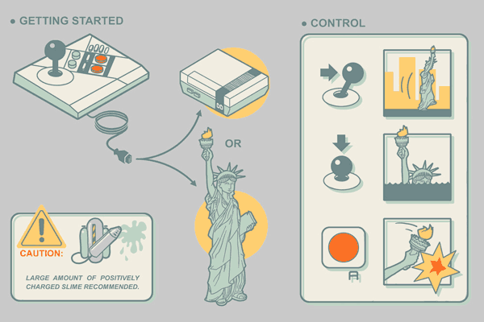
Dependency Properties
Magic goo of WPF
Enables:
Styles
Trigger
Animations
Binding

Slide 12
Dependency?
A dependency property depends on multiple providers for determining its value at any point in time – WPF Unleashed
Determine Base Value
Evaluate
Apply Animations
Coerce
Validate

Slide 13

DPs are our friends

Slide 14
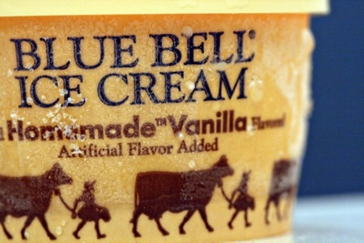
Vanilla Flavored DOs + DPs
GetValue
SetValue
As Property
In Xaml

Slide 15
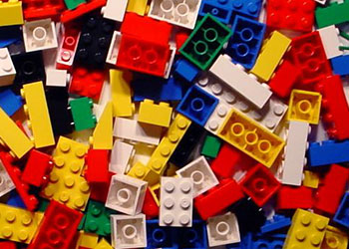
Create Your Own
Inherit Dependency Object
Have static property
Register Property
Set Property Type
Set Owner Type

Slide 16

Attached DPs
An attached property is a special form of dependency property that can effectively be attached to arbitrary objects – WPF Unleashed

Slide 17

In the ‘wild’
Grid.Row
Canvas.Left
DockPanel.Dock
ScrollViewer.CanContentScroll
TextElement.FontSize

Slide 18

Exploring Attached DPs
Setting
Getting
Creating our own
Register Attached
Static Get
Static Set

Slide 19
Remember this step?
Determine Base Value
Local value
Style Triggers
Template Triggers
Style setters
Theme style triggers
Theme style setters
Property value inheritance
Default value
Precedence

Slide 20
Default Value
No matter what DP and DO, if you ask for the value of a DP on a DO that doesn’t already have a value set, you will get the default value

Slide 21
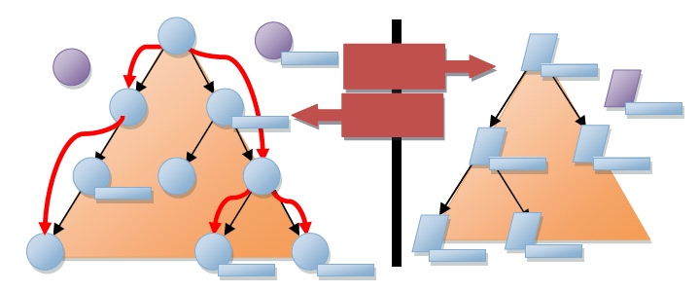
Inheritance
Refers to the flowing of property values down the element tree

Slide 22

PropertyChanged CallBack
Specify a callback method when the property is changed / this is also called when set

Slide 23
Behaviors
Leverage the PropertyChanged CallBack to attached additional functionality
Attached Dependency Property
Set CallBack
PROFIT

Slide 24


Blend Behaviors
Similar concept to Behaviors but with the power of BLEND
Integrated into Blend
And lemon scented….

Slide 25
Help! I’m not a designer!

Slide 26
Style
Sets Dependency Property Values
Reread that first line
Not just colors and font sizes
ALL Dependency Properties!

Slide 27
DRY
Don’t Repeat Yourself
Styles allow sharing the setting of values with multiple entities
TargetType
Sets scope of properties
And scope of application of style

Slide 28
Triggers
Common mistake
Don’t need to set Case A and Case B

Slide 29
Template
Provides the “Look” to “Look-less” controls
Property on Control

Slide 30
Hierarchy Revisited
Add explanations from the other slides

Slide 31
Named Parts

Slide 32
Style + Template
Interview question
Use Style to set Template

Slide 33
Resources + Dictionaries
Move styles to resources and resource dictionaries
App xaml
Merged Dictionaries

Slide 34
Anything can be a resource
Style
Template
Converter
Object
Anything…

Slide 35

Static vs Dynamic
Static – applied only once
Dynamic – reapplied every time it changes

Slide 36
Skinning
Leverage the swapping ability of dynamic resources to be able to change the look of an application

Slide 37
Load from File
Load Resource Dictionary from file
Use File watch on directory and dynamic refresh

Slide 38
Resource Dictionary Loader
Load Resource Dictionary from Assemblies
Use MEF to load from directory

Slide 39
Colors + Brushes
Anything is a resource?
Colors!
Brushes!

Slide 40
Markup Extensions
Enable you to extend the expressibility of XAML
Examples
{x:Null }
{Binding …}
{StaticResource }
{DynamicResource }

Slide 41
Custom Markup Extension
Inherit MarkupExtension
Object name include MarkupExtension
Override abstract method

Slide 42
Inverse Color

Slide 43
Lighten Color

Slide 44
Gradients
Gradient with Lighten

Slide 45
Fonts
Fonts as Resources
Semantic Font

Slide 46
Serif vs San-Serif

Slide 47
Embedding a font
Open Source fonts
http://ingebretsen.posterous.com/10-favorite-open-source-fonts-you-can-embed-i

Slide 48
Bitmap Effects
Why is it obselete
performance

Slide 49
Effects
Uses Graphic Card
Drop Shadow
Drop Shadow -> Glow
Effects as resources

Slide 50
Semantic xaml

Slide 51
The Broken Workflow
Why do we need to improve the workflow
Expensive
Time consumng
Painful
Users deserve and demand better UIX
No technical limitations

Slide 52
How can we improve the design workflow?

Slide 53
WPF + Xaml
WPF and XAML is not designer friendly
Designers know colors and fonts but not tech of WPF

Slide 54
Visual Editors
Are failing designers
No editor will help (relate to web)
Do web designers use Dreamweaver?
The good ones don’t
No editor has adequately solved the problem of what they see into meaningful markup

Slide 55
Blendability
“You can’t do that because it doesn’t work in Blend”
The ability of a M-V-VM or an application to be open in Blend
Ward Bell : Of Tailors and Tooling

Slide 56
WPF vs Winform
Reconsider old fashioned ideas
Don’t think drag and drop

Slide 57
ML = Markup Language
If XAML is a markup, what other markup language do we know of?
HTML!
We should learn from the web that has YEARS of UI markup XP
Evaluate how you think about and use markup

Slide 58

In markup, semantics is concerned with the meaning of an element and how that element describes that content it contains
– Molly Holzschlag

Slide 59
What is Semantic Xaml

Slide 60
Why Semantic Xaml
Meaningful markup and structure simplifies design
Position meaningful semantic markup at the center of everything you create

Slide 61
Naming
Names should relate to context and not appearance
Save you working and thinking time, because they leave you free to design rather than sit around wondering.. ?
Setup semantic naming conventions
Reduces the time it takes to mentally deconstruct a doc and reduce margins and costs of errors
Helps in teams
Make it simplier to understand the markup that has been written by another developer

Slide 62
Breakdown Apps
Get some screen shots and then breakdown screen

Slide 63
Custom Controls
Declare semantic controls
Allows setting styles by target type
No preconceived ideas on template implementation
Label template that uses a Listbox would be confusing
Section Title example

Slide 64
WPF Truth
XAML
Code

Slide 65
Clean Xaml
We get upset if our classes are heavily nested and over 1k lines long but have no issue with our xaml files?
Adding nested elements increases the likelihood of errors creeping in during design

Slide 66
Visual Editor = Code Gen
We should have the same hesitation over using a visual editor as we do using code generation.
All xaml is code
All visual editors generate xaml
Then all visual editors generate code

Slide 67
Presentation & Structure
I committed the hangable offense of mixing structure with presentation – David Siegel

Slide 68
Separation of Concerns
UI Interaction and logic
Structure and presentation
Focus on content and not presentation
Brings back to editors suck!
Great layout panels and then you just drag and drop fixed margins into a grid? WTF!?

Slide 69
Displaying Buttons
Instead of displaying a stackpanel with a collection of buttons, lets display an actions control with a collection of actions

Slide 70
Specialists?
Manage the connections between specialists
Think about the way you work and how you collaborate with others
Designers vs Developer
“Dev” – “igners”
Need to see both the design and the code
See the matrix!
Also need to know WPF’s tech capabilities to facilitate creating better UI + design workflow

Slide 71
Form
Why can’t we have a control that figures out what fields to display?!
Let’s do it

Slide 72
Rethink grids

Slide 73
Grids are inadequate
Grids represent data
But everything isn’t data
Destroy some myths

Slide 74
All the world is a list

Slide 75
Data Templates
Using Keys
Using DataType

Slide 76
Item Container Style
Style item
Selected Style

Slide 77
Items Panel
Sets the panel to use to host the items
IsItemsHost
VirtualizedStackPanel
Tab Control
Animated StackPanel

Slide 78
Reference
Ward Bell : Of Tailors and Tooling
http://neverindoubtnet.blogspot.com/2010/03/of-tailors-and-tooling-rant.html
Herding Code : Scott Bellware on HTML Specialists
http://herdingcode.com/?p=232

